Slide 1

Monitorización automática de condiciones ambientales para espacios cerrados
Automatic monitoring of environmental conditions in indoor spaces
Trabajo de Fin de Grado
Roi López Barata

Slide 2

Index
Objectives
Market research
System architecture
Firmware and hardware
Stations
Encryption
Advanced handshake
Central stations’ connectivity
Web application
Key results
Bibliography

Slide 3

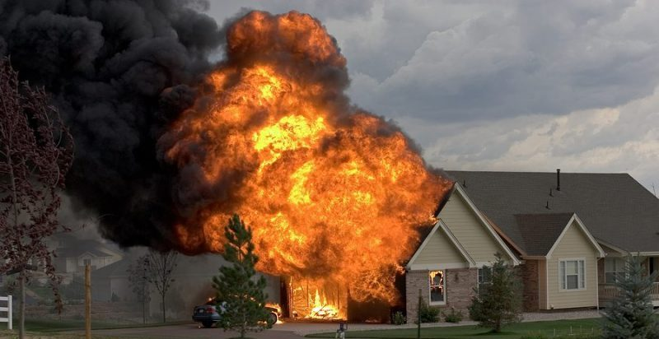
Objectives (I)
[1]
[2]
01/15

Slide 4
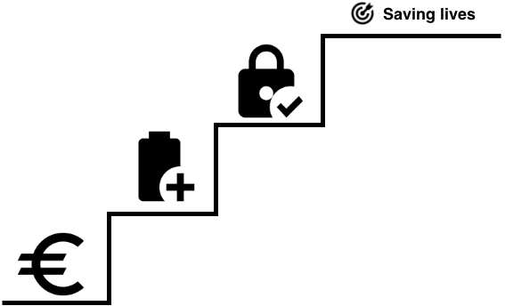
Objectives (II)
02/15

Slide 5
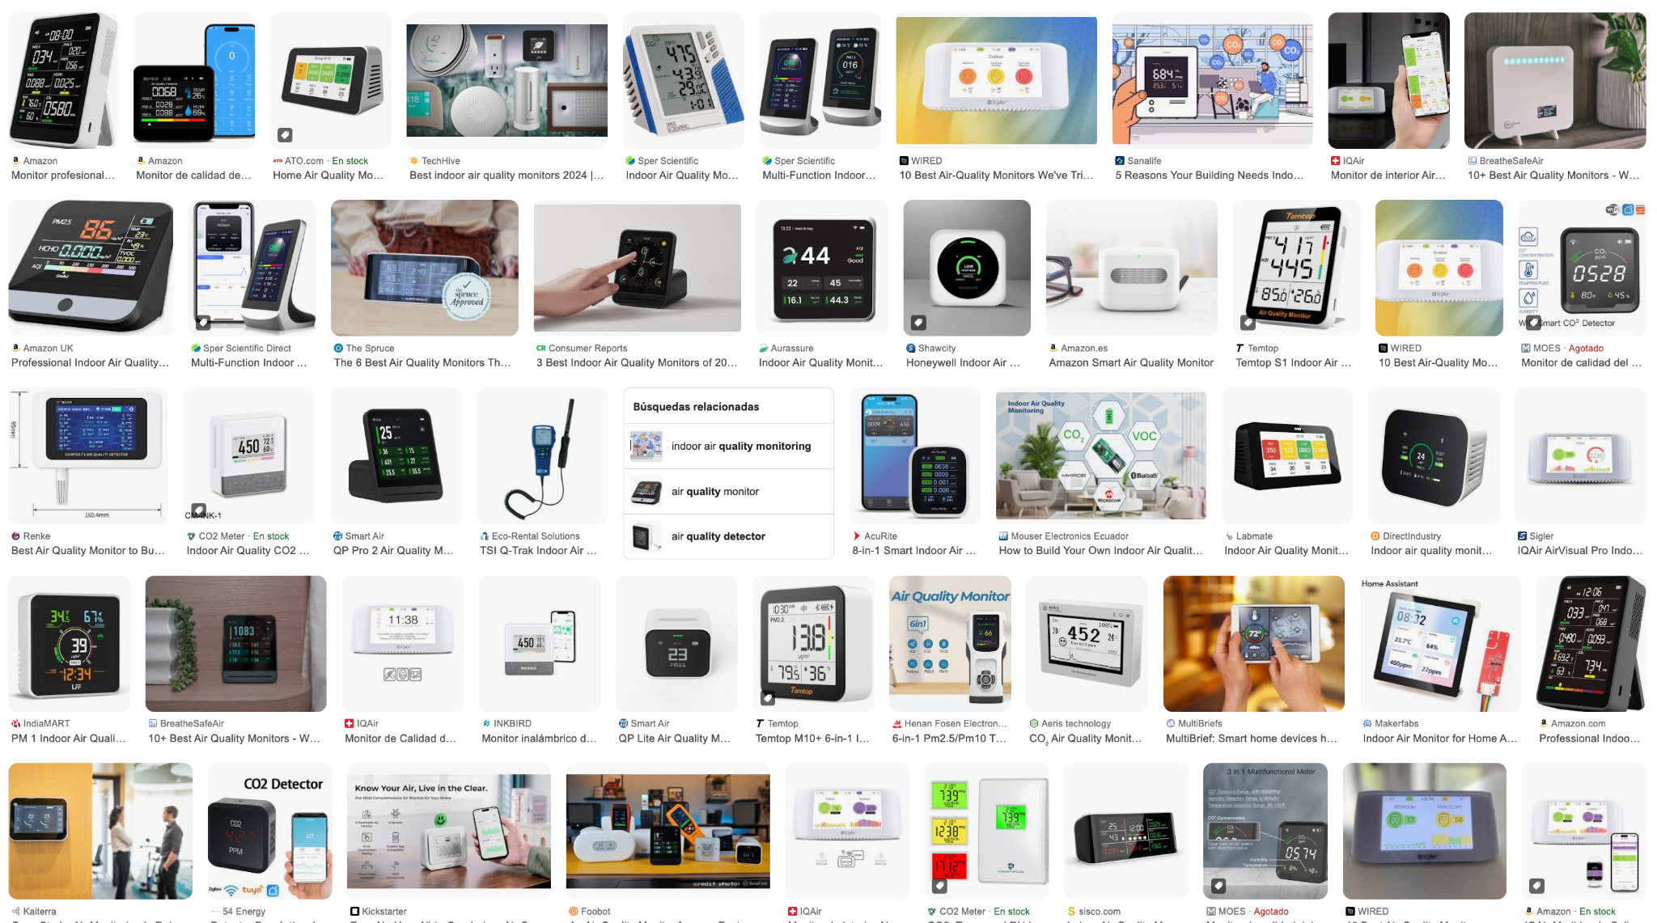
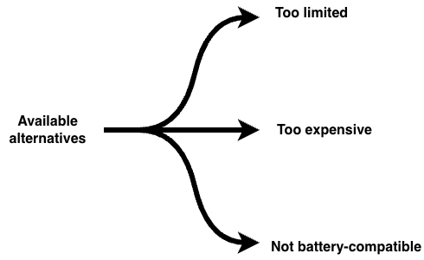
Market research
03/15

Slide 6
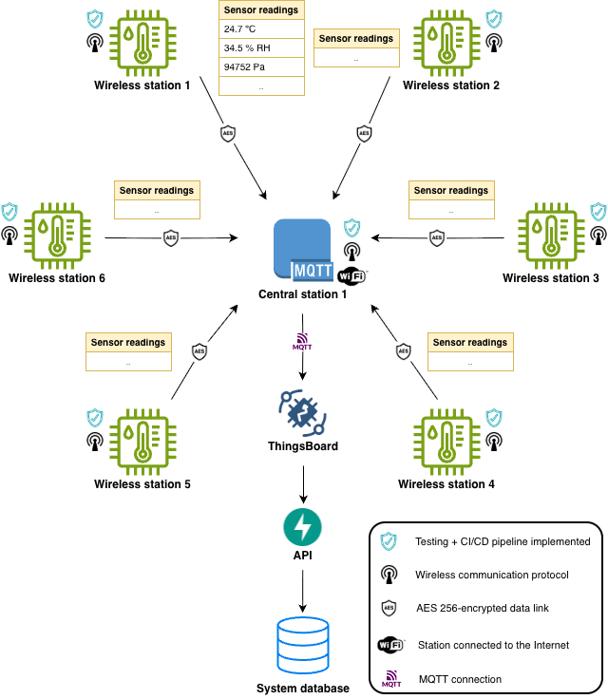
System
architecture
04/15

Slide 7

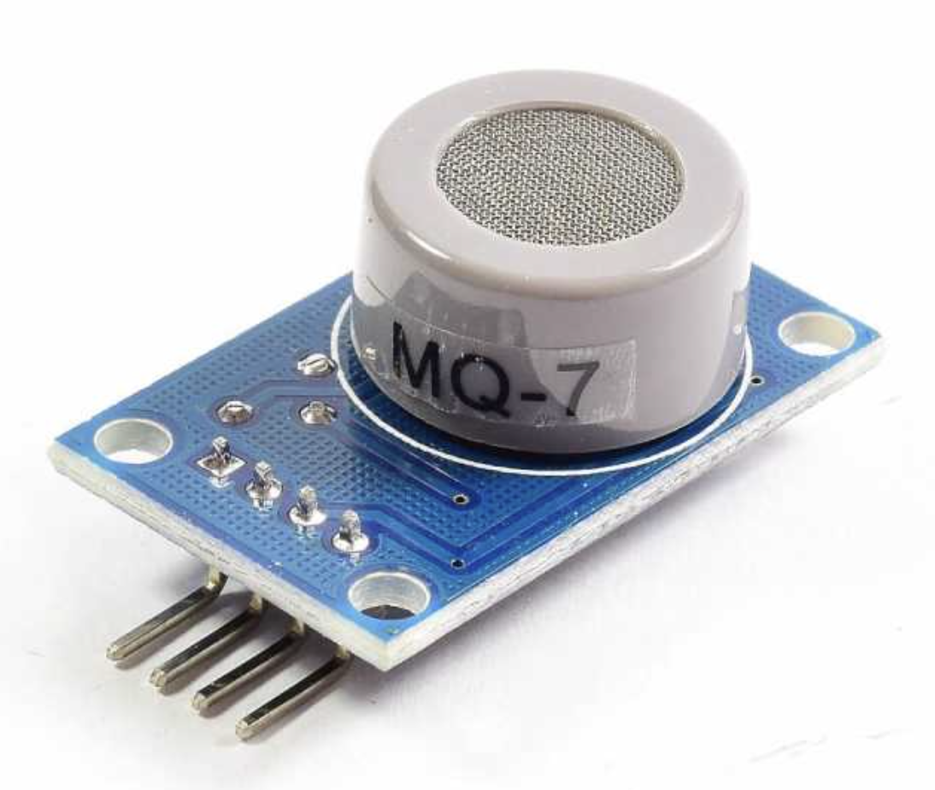
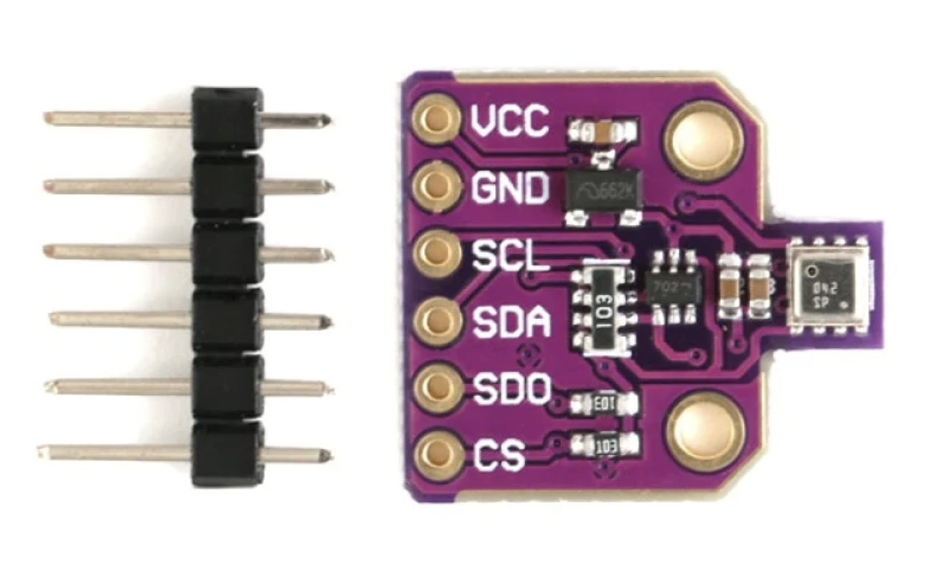
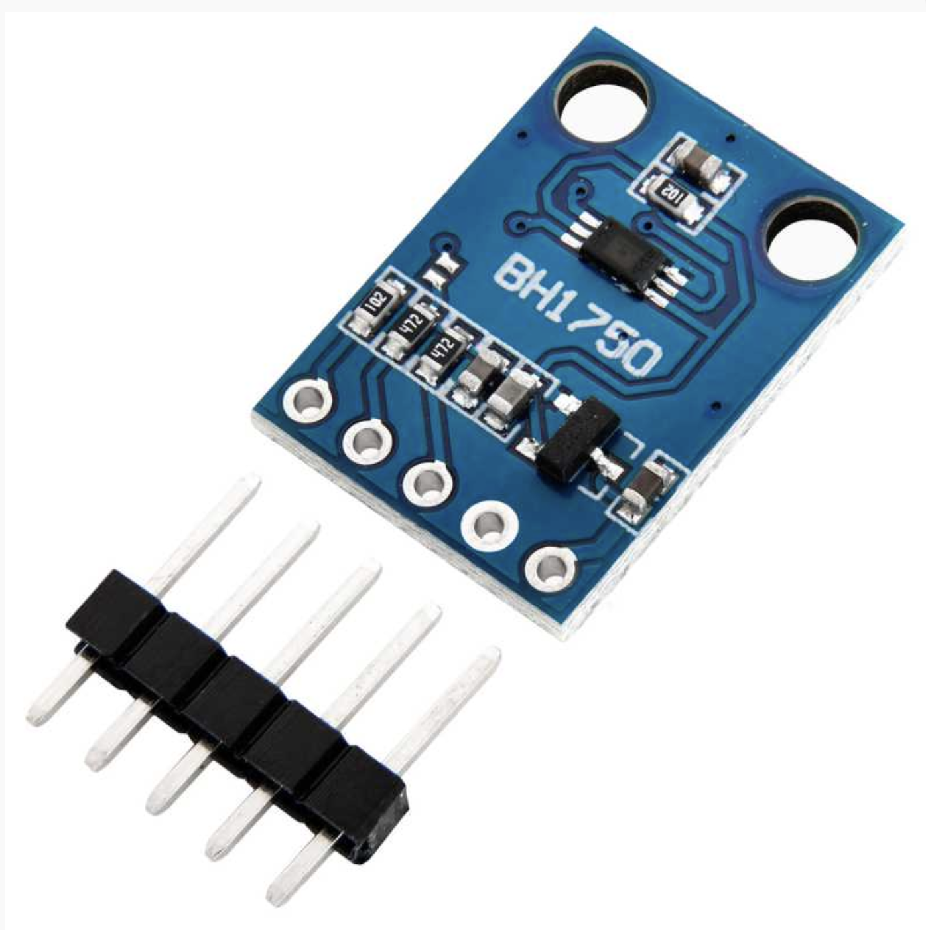
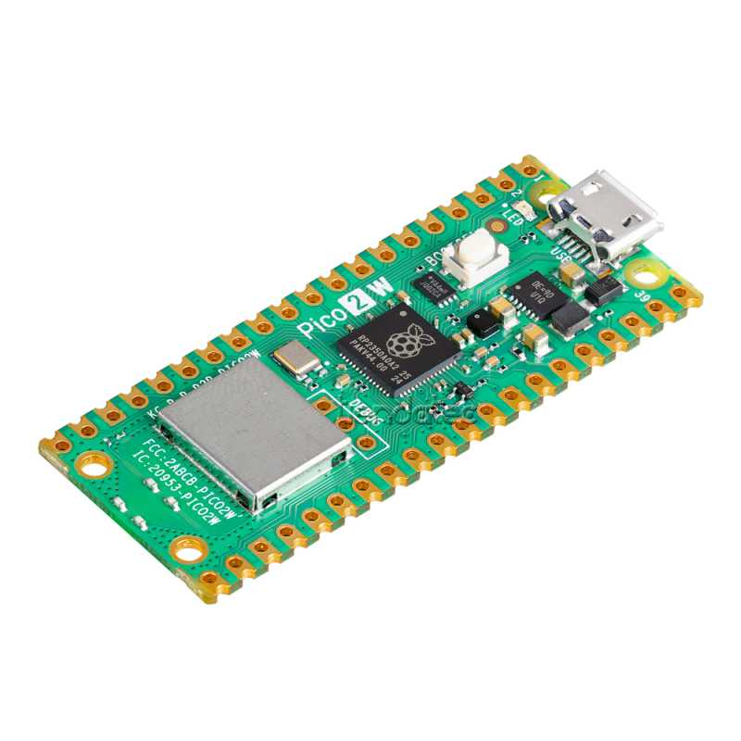
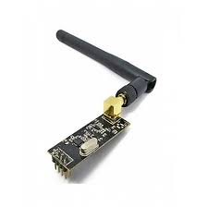
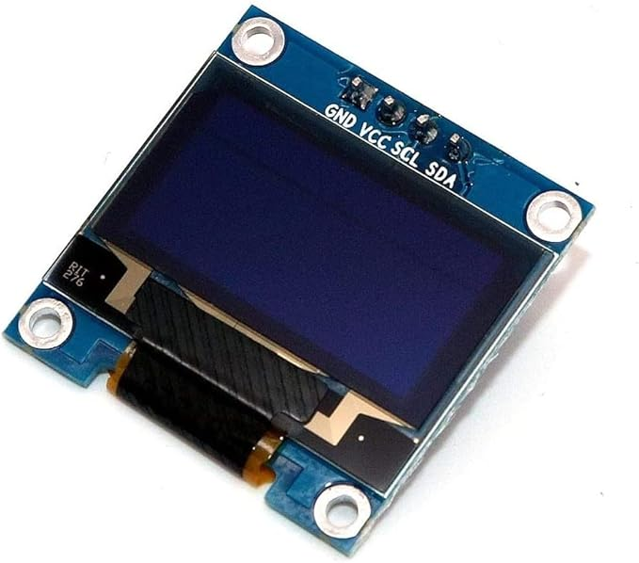
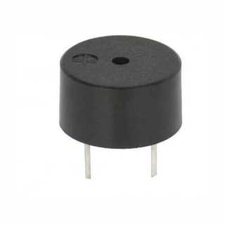
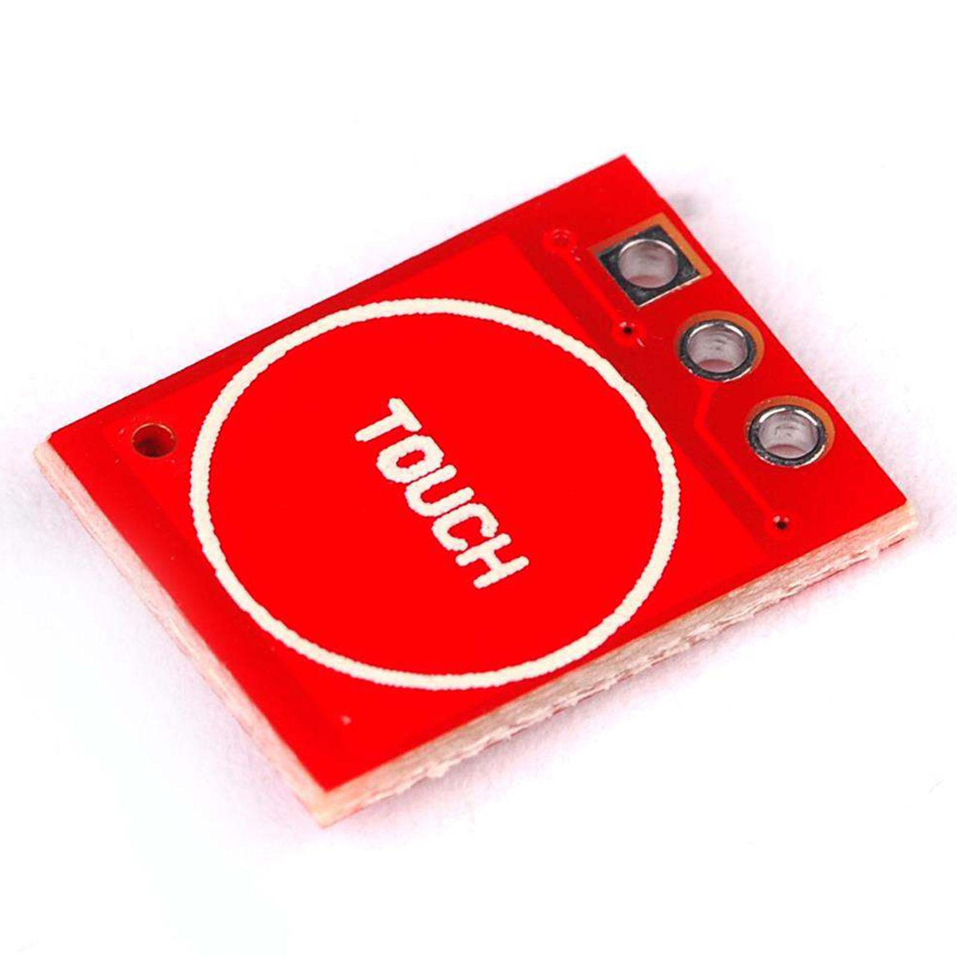
Firmware and hardware
[3]
[4]
[5]
[6]
[7]
[8]
[9]
[10]
[11]
05/15

Slide 8
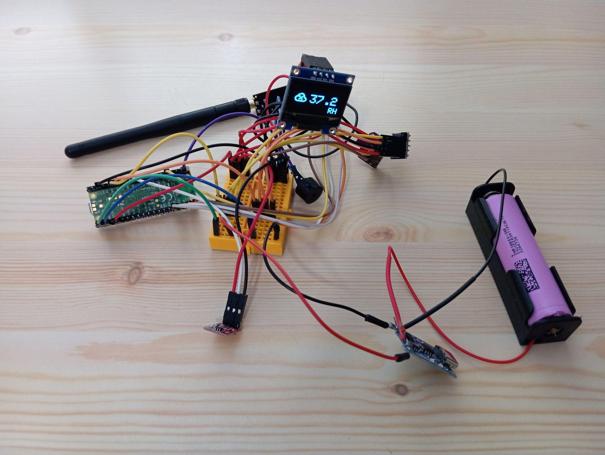
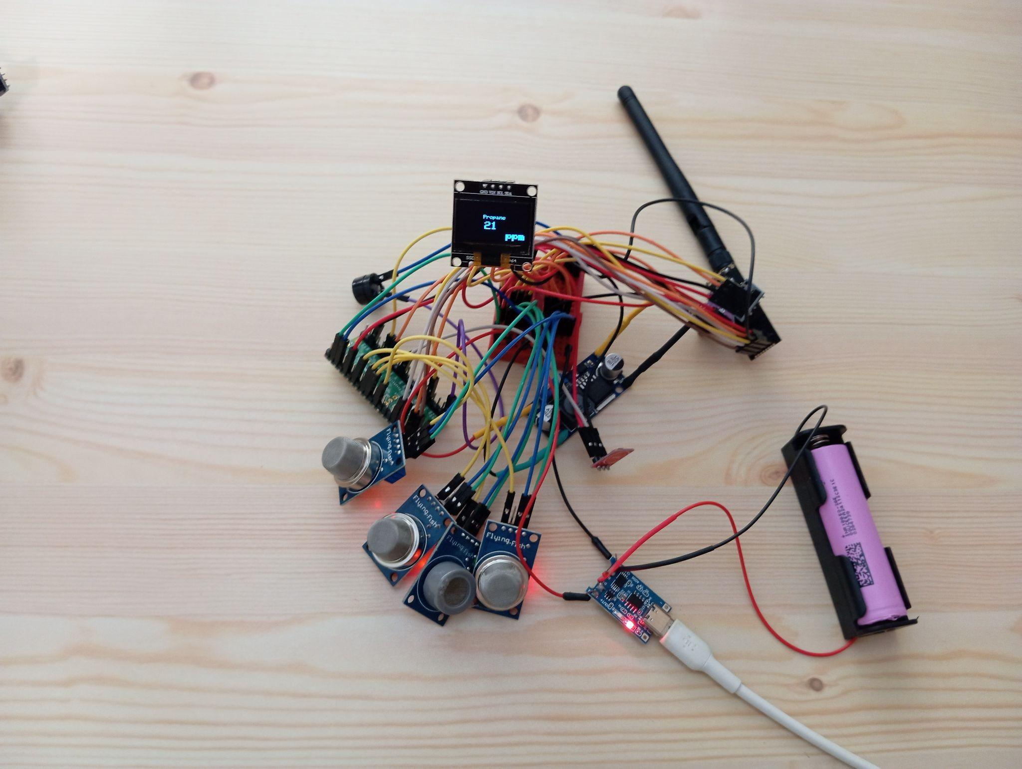
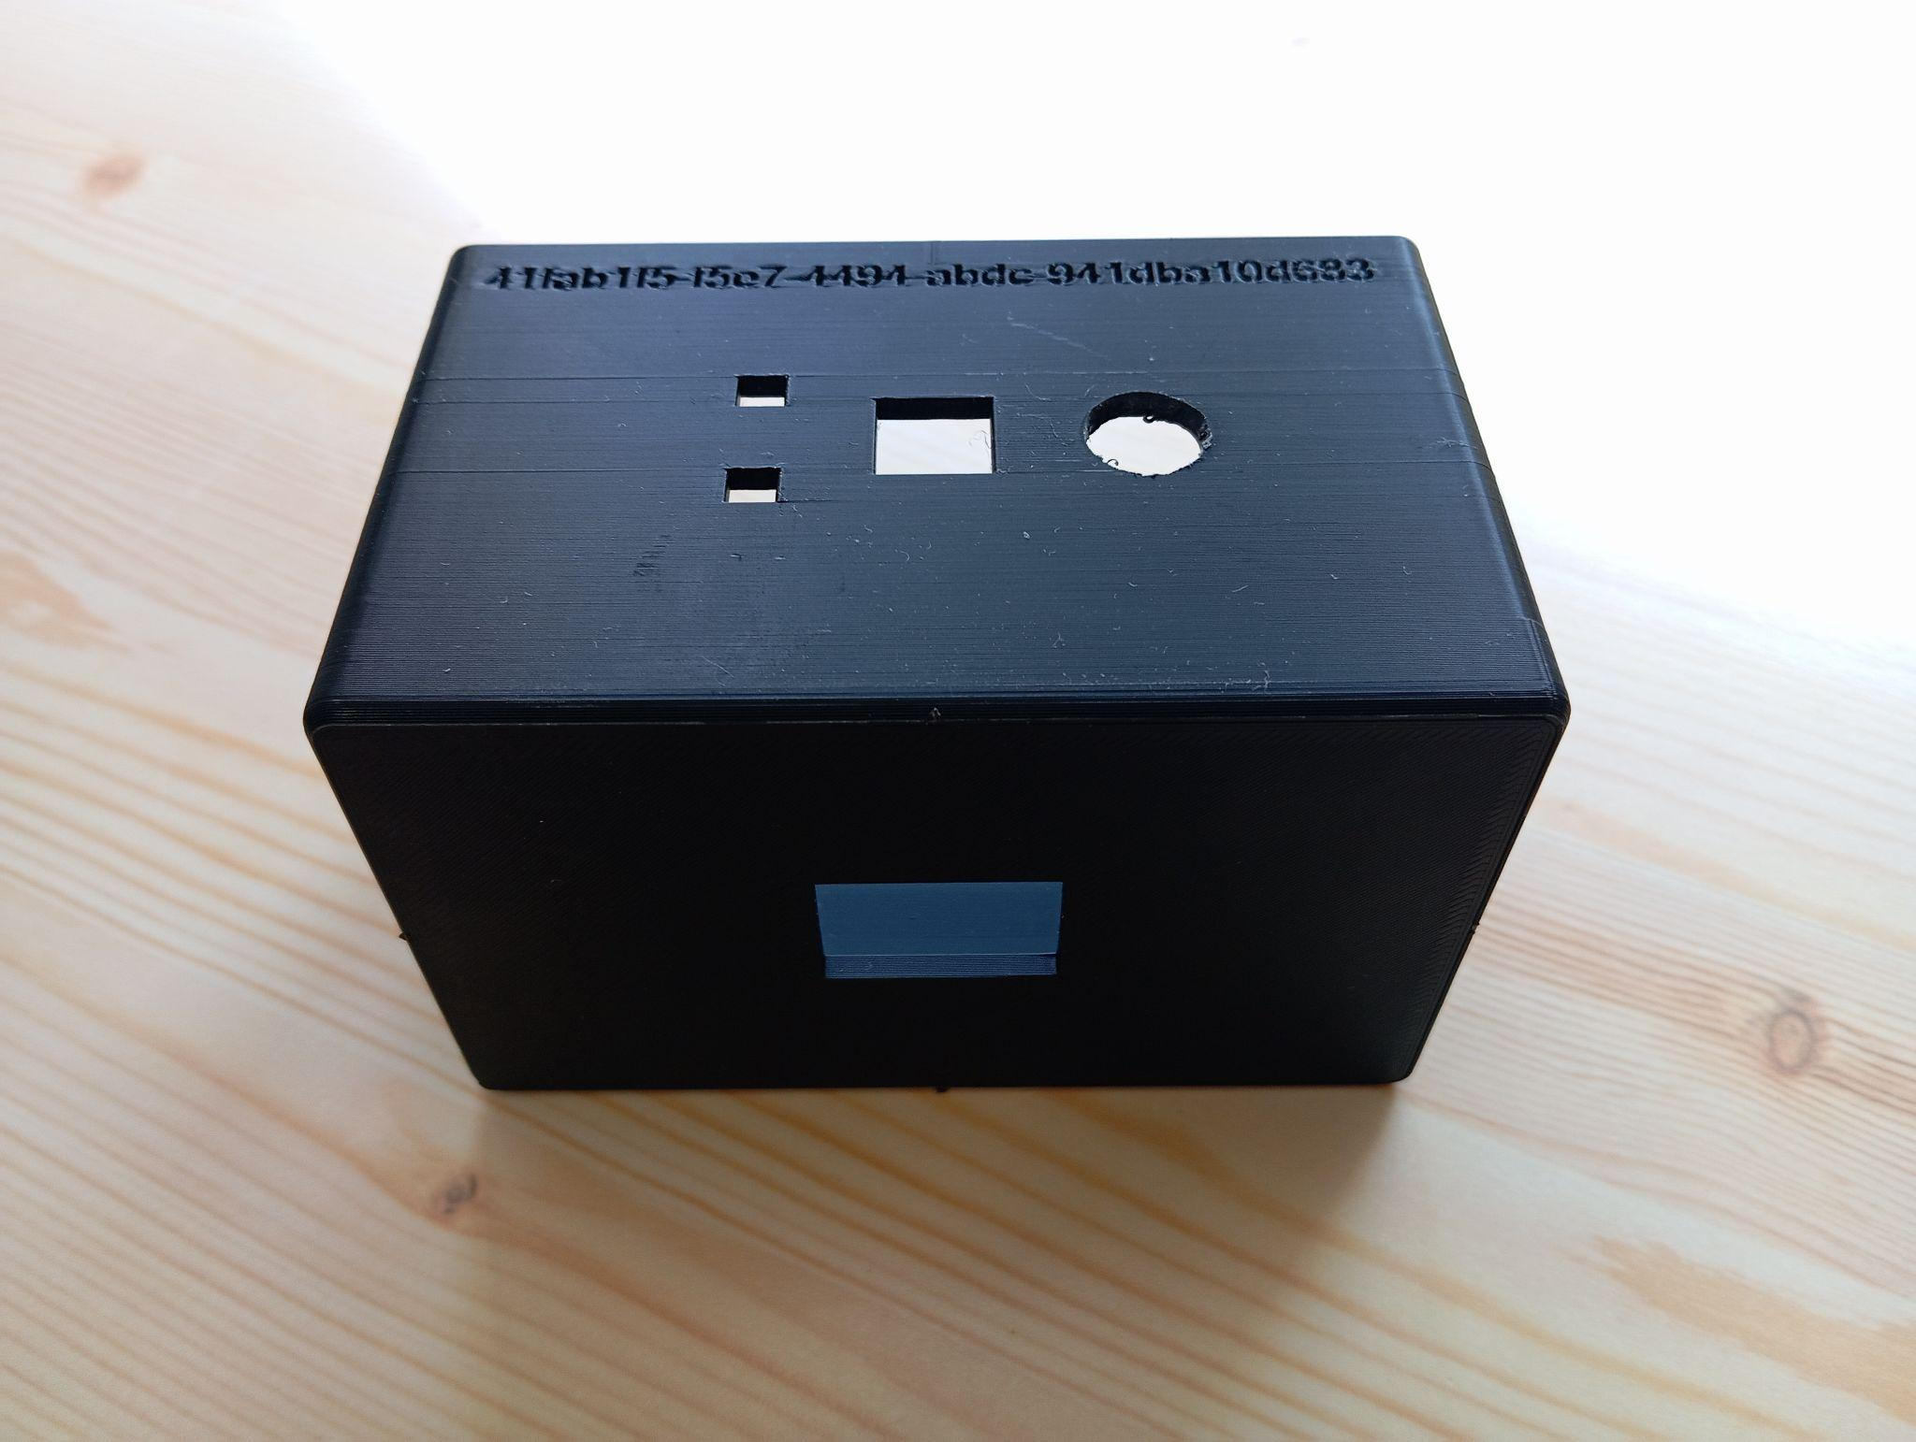
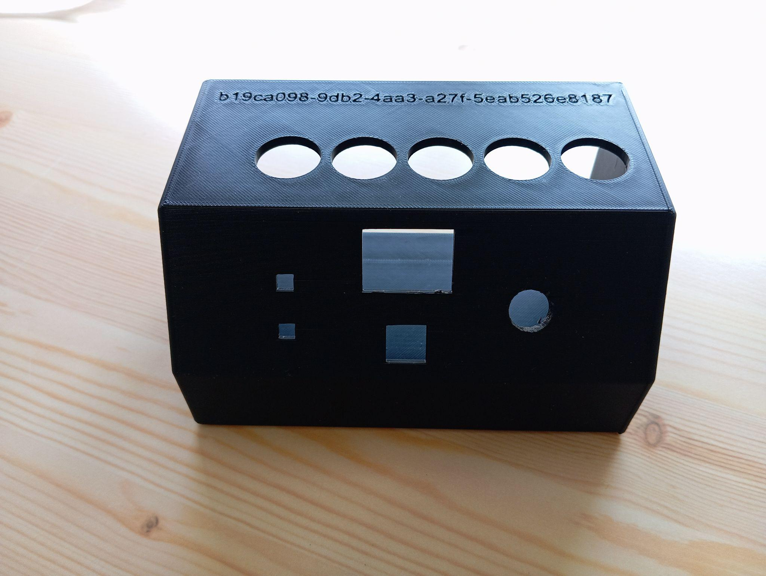
Stations
06/15

Slide 9
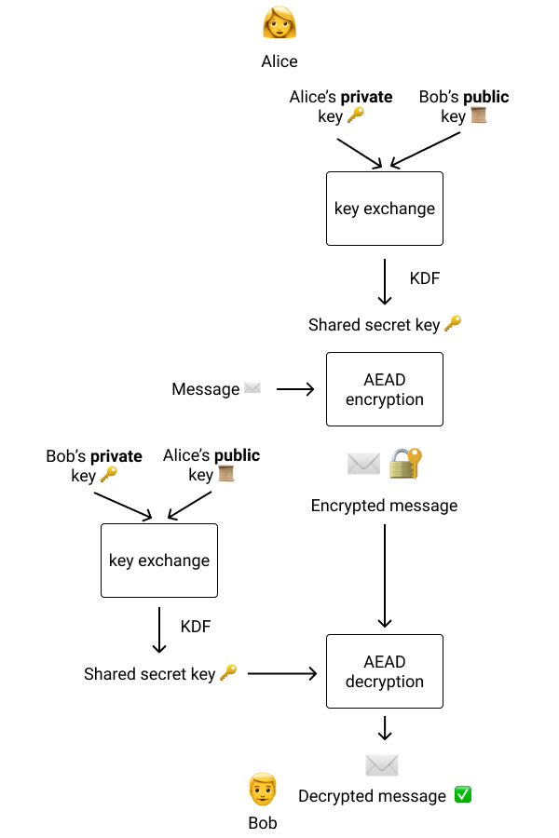
Encryption
[12]
07/15

Slide 10
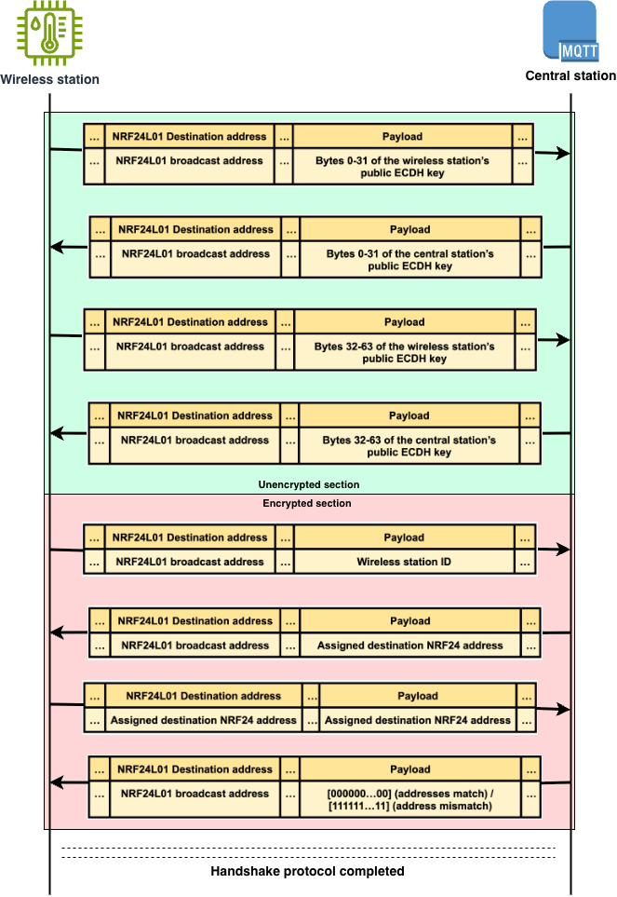
Advanced
handshake
08/15

Slide 11

Central stations’ connectivity
09/15

Slide 12
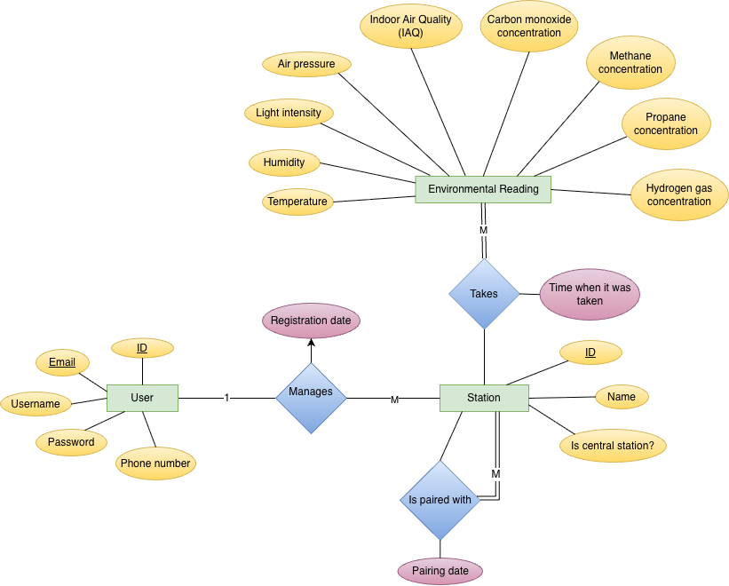
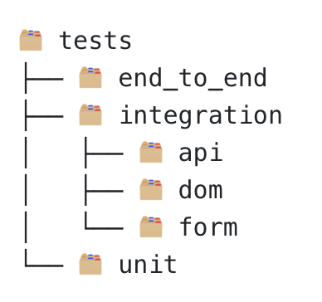
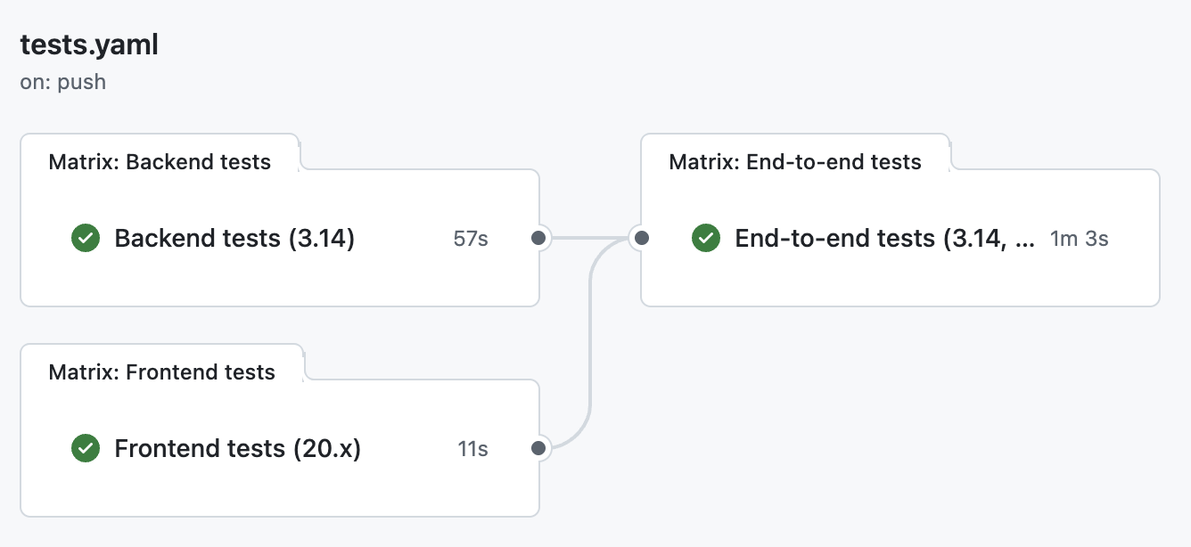
Web application (I)
10/15

Slide 13
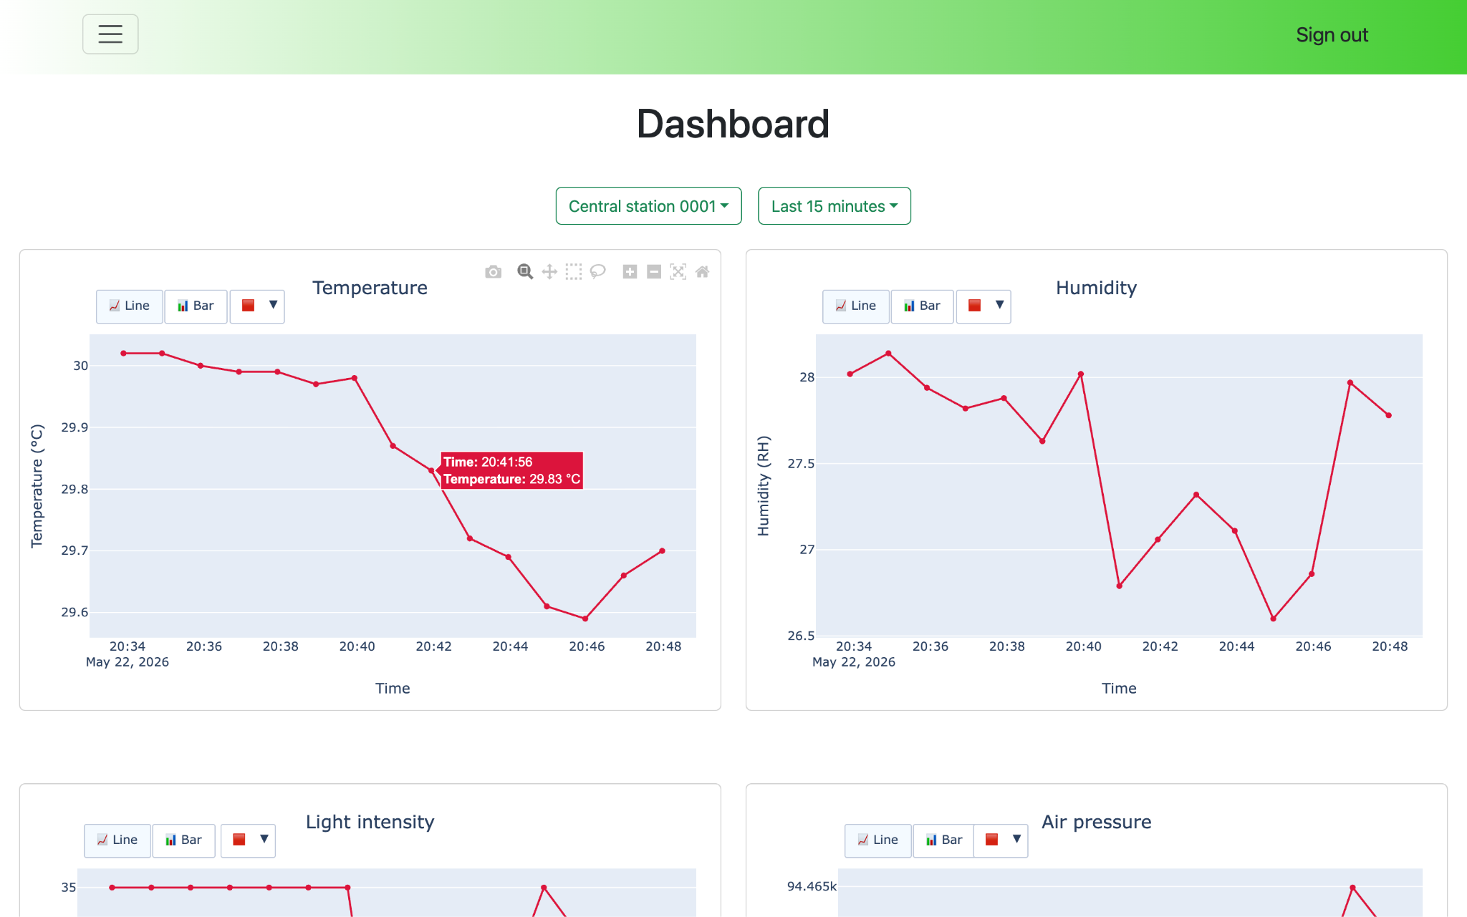
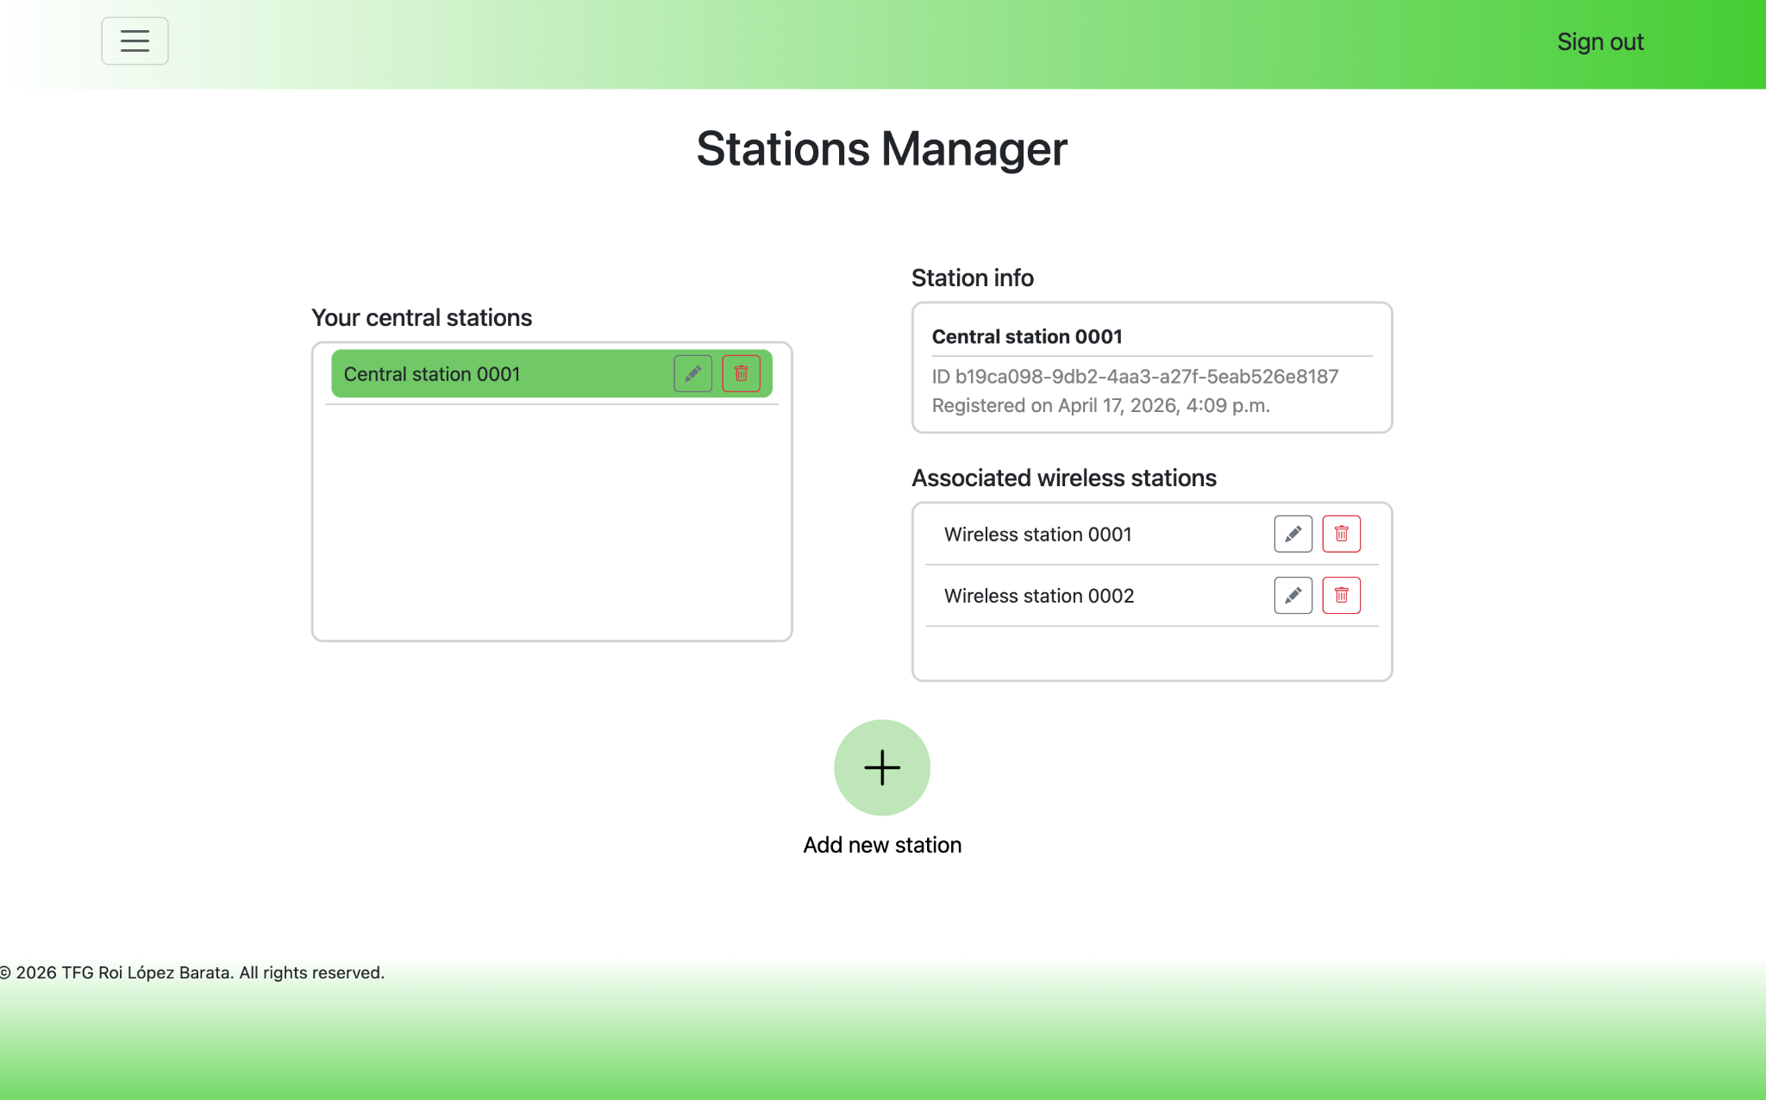
Web application (II)
11/15

Slide 14
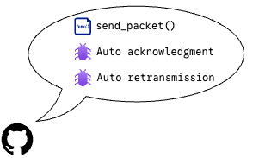

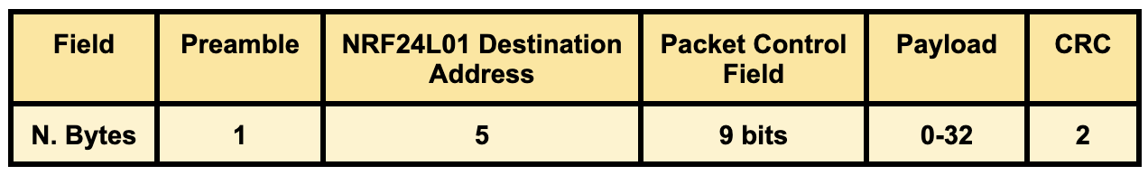

Results (I)
[13]
12/15

Slide 15
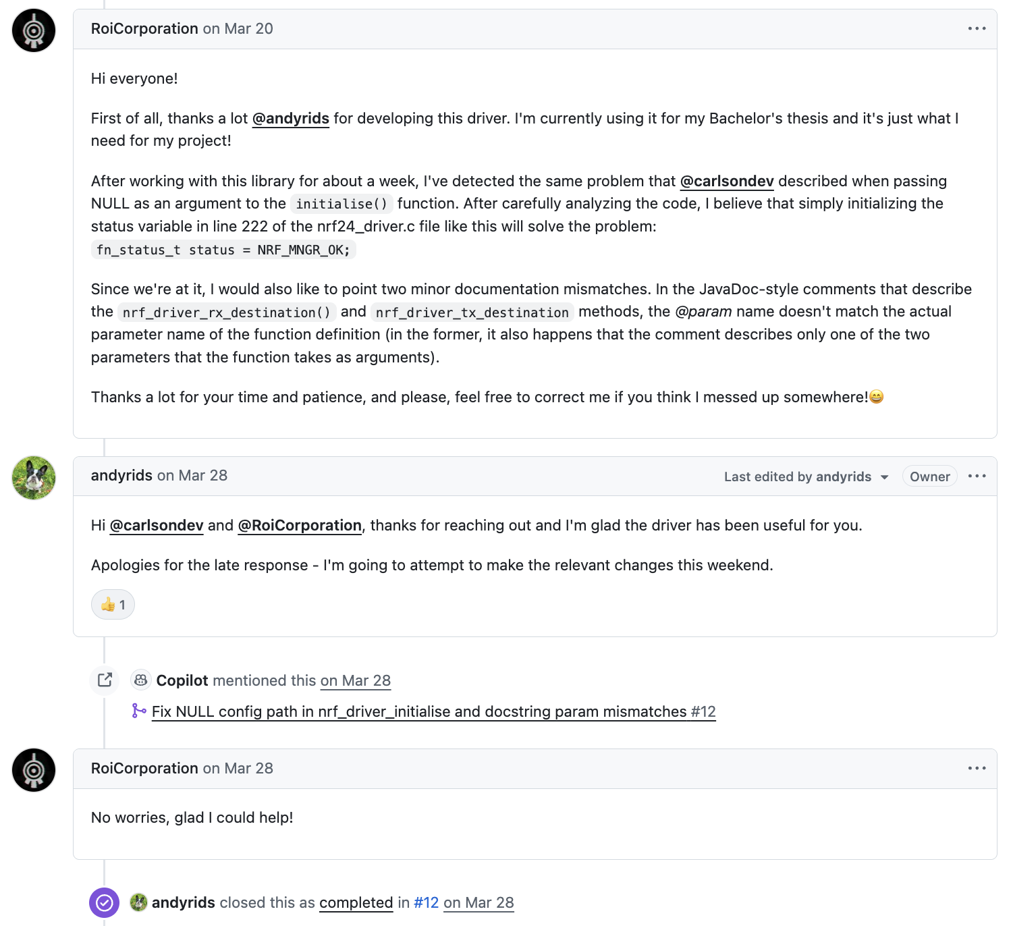
Results (II)
13/15

Slide 16




Results (III)
Wireless stations ≈ 45 €
Central stations ≈ 60 €
I_{avg} = 1.176 mA
4 months of battery life
ECDH + AES-256 + [BLAKE2b + ChaCha20]
14/15

Slide 17
Bibliography
[1] https://www.safelincs.co.uk/blog/2024/06/19/why-is-carbon-monoxide-dangerous/
[2] https://www.napolilaw.com/article/common-causes-house-fires/
[3] https://www.raspberrypi.com/trademark-rules/
[4] https://satkit.com/sensor-bme680-arduino-temperatura-humedad-presion-gas
[5] https://www.tiendatec.es/maker-zone/modulos/1565-sensor-mq-9-detector-gas-monoxido-carbono-8472496020886.html
[6] https://www.tiendatec.es/maker-zone/modulos/2580-modulo-sensor-de-intensidad-de-luz.html
[7] https://www.tiendatec.es/raspberry-pi-pico/2423-1396-raspberry-pi-pico-2-w.html#/249-version-sin_pines
[8] https://www.flyrobo.in/2.4ghz-nrf24l01-pa-lna-sma-wireless-transceiver-antenna
[9] https://www.amazon.es/dp/B09Z2H16JF
[10] https://www.tiendatec.es/electronica/componentes/buzzers/655-buzzer-zumbador-pasivo-electromagnetico-5v-8406551370005.html
[11] https://alltopnotch.co.uk/product/ttp223-mini-red-capacitive-touch-switch-button-self-lock-no-lock-module-arduino/
[12] https://kerkour.com/end-to-end-encryption-key-exchange-cryptography-rust
[13] https://reolink.com/blog/how-to-change-wifi-to-2-4ghz/
All figures that do not explicitly mention a source are owned by the author of this document.
15/15

Slide 18
Ready to save lives?

